Slide 1
Introduction to Logistic Regression

Slide 2

Introduction to Logistic Regression
Logistic regression is a classification model
Classification models predict a discrete value

Slide 3
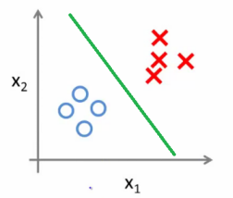
Let’s take an Example
Y = mx + c
Y = W.dot(X) + c

Slide 4
Scenario for House Price Prediction
location
# rooms
Dist from landmark
Logistic Regression
Buy (yes)/(no)
Age of House
Target (Y)
Dist from graveyard

Slide 5
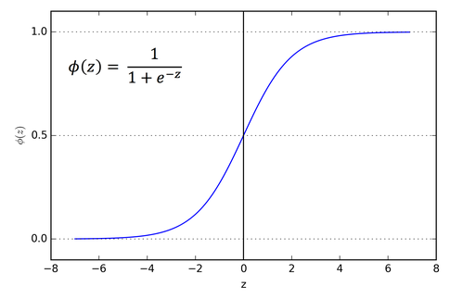
The Sigmoid Function
Z = X.dot(W) + C
If z = Inf :
1/(1+e(-Inf)) = 1/(1+0) ~ 1
If z = -Inf :
1/(1+e(Inf)) = 1/(1+Inf) ~0

Slide 6
Thresholding
Any value equal or above the threshold is given the upper limit and value below the threshold will be given the lower limit
If Threshold = 0.5
Sigmoid(Z) = 0.49 then Prediction = 0
Sigmoid(Z) = 0.51 then Prediction = 1

